Slide 1
FINAL PROJECTS
COMPUTER INFORMATION TECHNOLOGY (CIT)

Slide 2
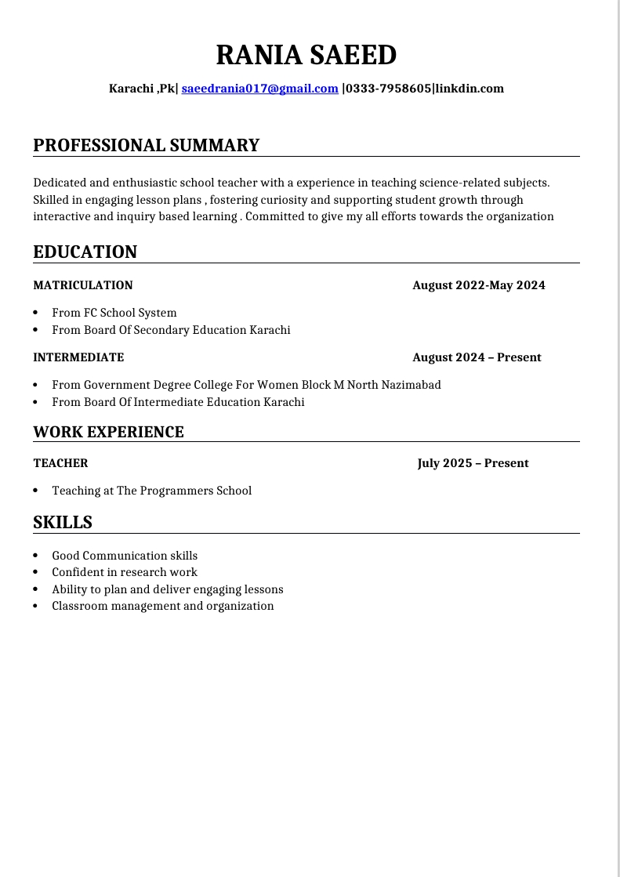
RESUME
This is my resume with ,
The size of page A4.
The margins are narrowed.
The total sections are 4 .

Slide 3
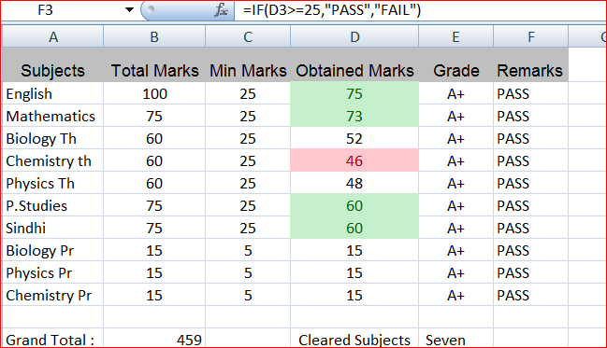
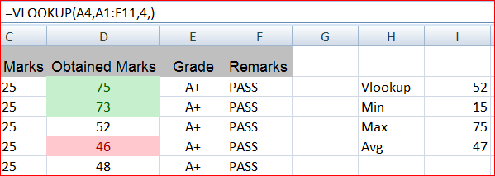
EXCEL SPREADSHEET
Here is the spread sheet of marks of a student .
The grand total numbers are added by using the formula of “SUM” .
At the section of remarks the formula of “IF” is used.
To lookup the value we used the formula of “ VLOOKUP”.

Slide 4
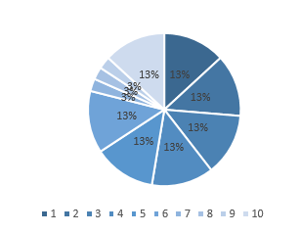
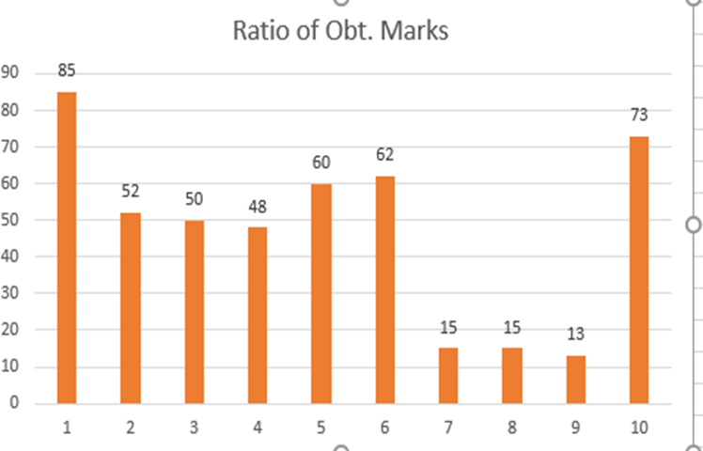
THE CHARTS
Here are the charts :
There is pie chart.
The other one is line chart where ratio of obtained marks are given.

Slide 5
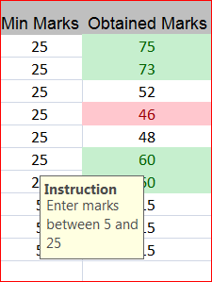
DATA VALIDATION AND CONDITIONAL FORMATTING
Here we add the validation of data which restricted the user to only enter that data which is instructed .
Secondly , the conditional formatting which is based on a condition to highlight the cell.

Slide 6
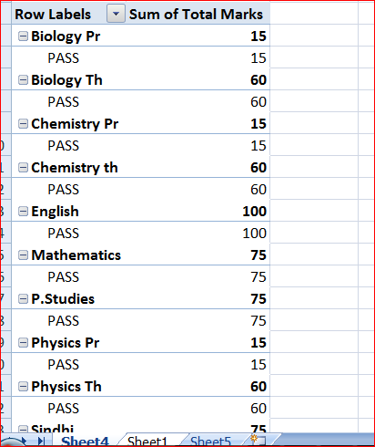
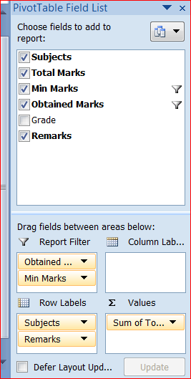
PIVOT TABLE
Here is the pivot table
For larger data set we arranged the data in Pivot table.
Here we “Filter” the data
Sum the data and can add separately in the rows and columns .

Slide 7
THANK YOU FOR WATCHING
By Rania Saeed

